Slide 1
Web Development Project Presentation
Assalamu Alaikum Everyone
Today I will show our Web-Development Project. Hope Everyone will see…

Slide 2
HASSLE FREE HEALTH CARE
Web Development Project Presentation
The project we create for web development is called Hassle Free Health Care. It is a medical category website. The purpose of making this website is to bring current medical services to the doorstep of common people. To that end, we hope to achieve our goals by using our website, and we move toward that goal.

Slide 3
Web Development Project Presentation
Languages Used In Project
This project is made up of HTML, CSS, JavaScript, Bootstrap, PHP and MySQL. The website is designed with HTML, CSS, Bootstrap and JavaScript. The backend of the website is built with PHP and MySql.

Slide 4
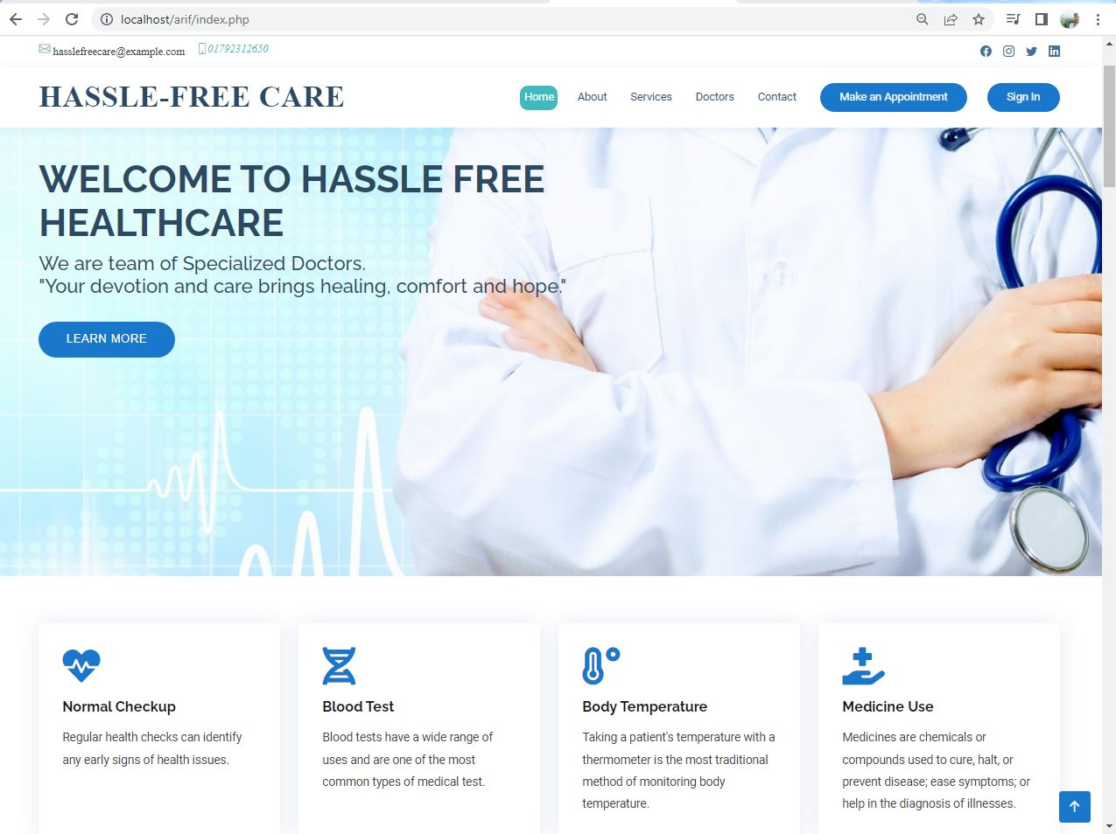
Website Interface
Web Development Project Presentation

Slide 5
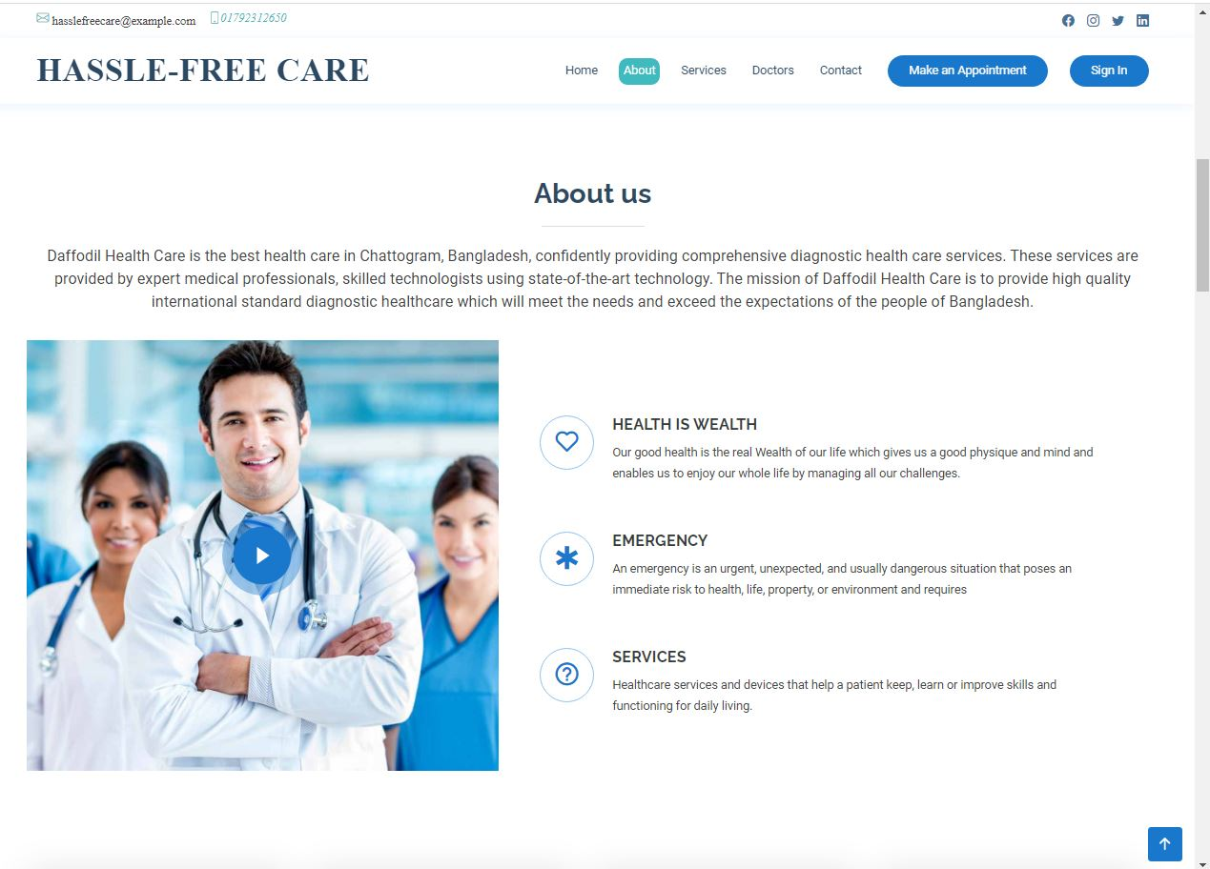
About Section
Web Development Project Presentation

Slide 6
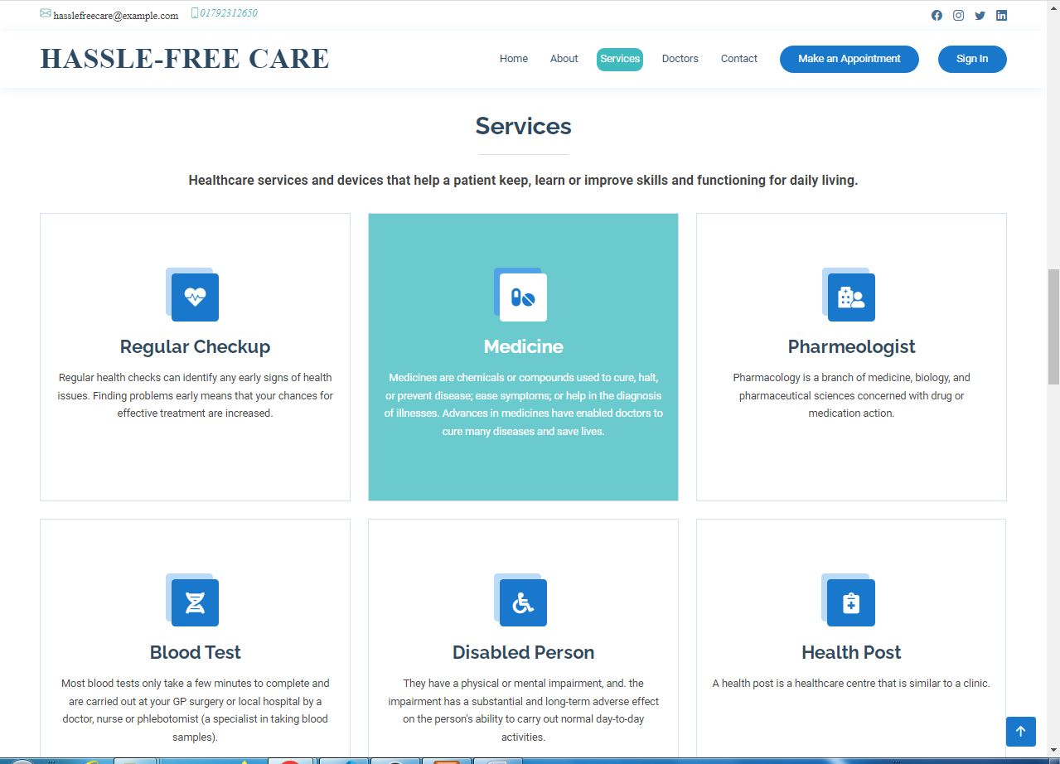
Services Section
Web Development Project Presentation

Slide 7
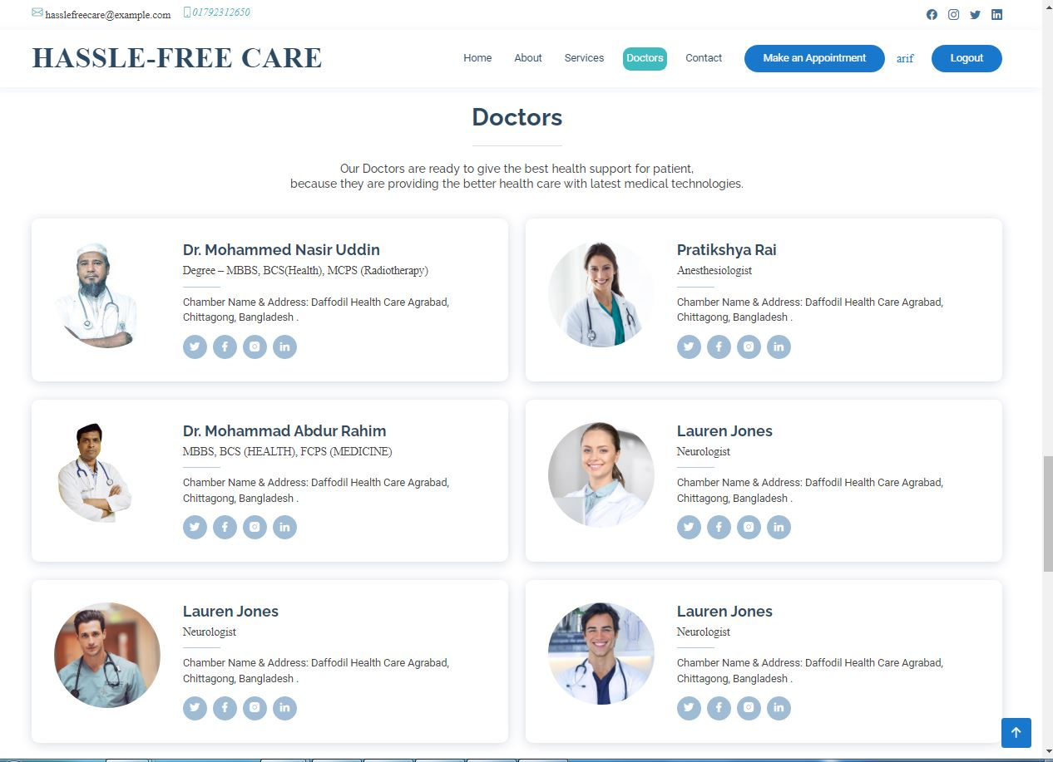
Doctors Section
Web Development Project Presentation

Slide 8
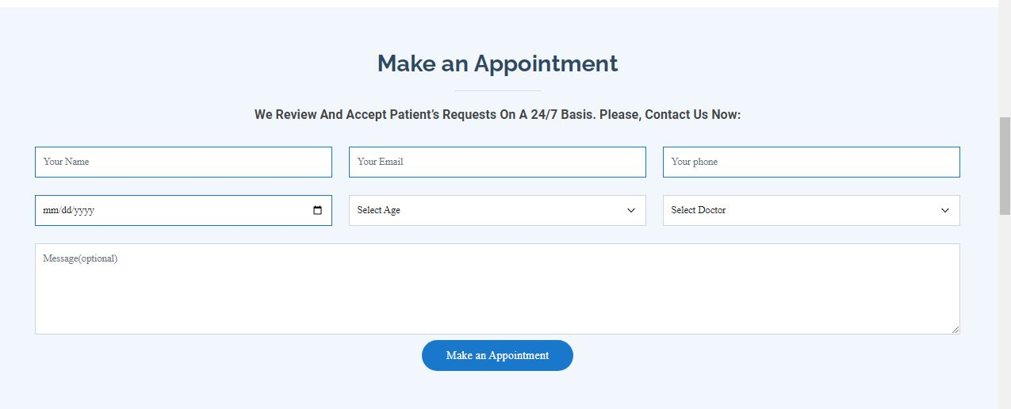
Appointment Section
Web Development Project Presentation

Slide 9
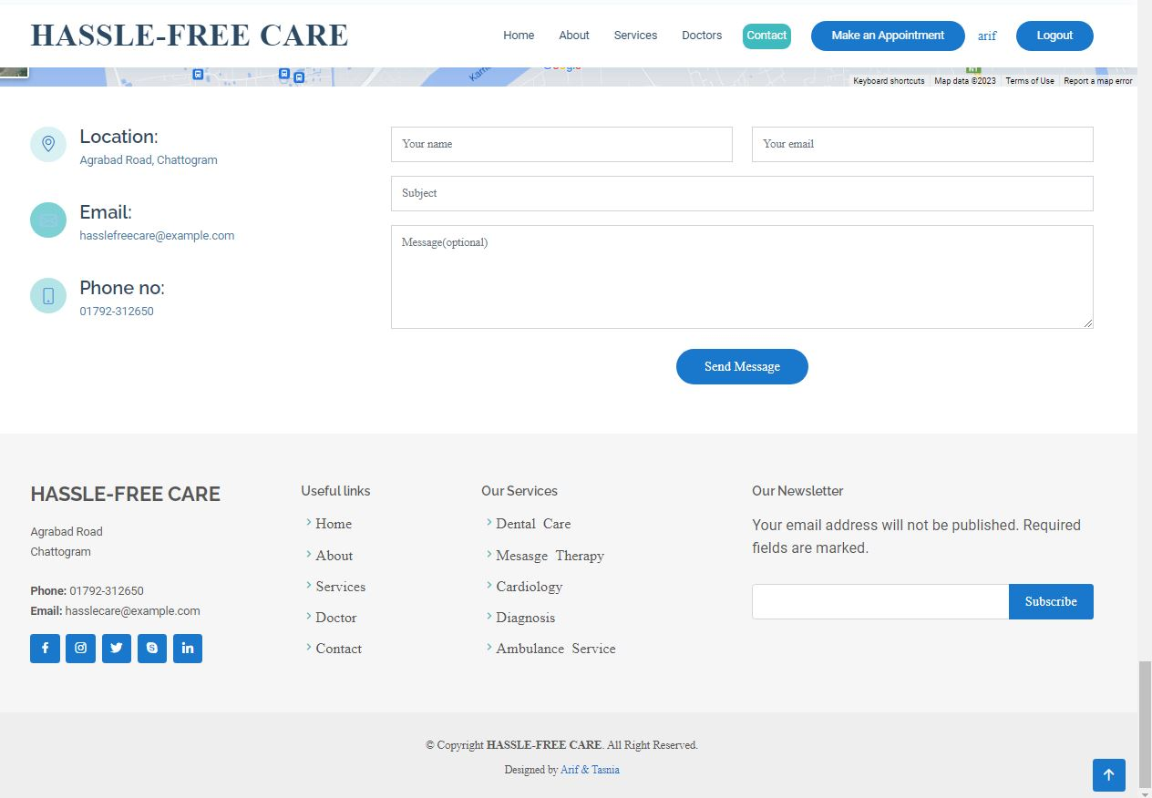
Footer Section
Web Development Project Presentation

Slide 10
Web Development Project Presentation
Thank You Everyone To Give Me Chance For Presentation…
Assalamu Alaikum.

